Slide 1
Climate Change and Tropical Forests
A Message from Save the Rainforest www.savetherainforestnow.org

Slide 2
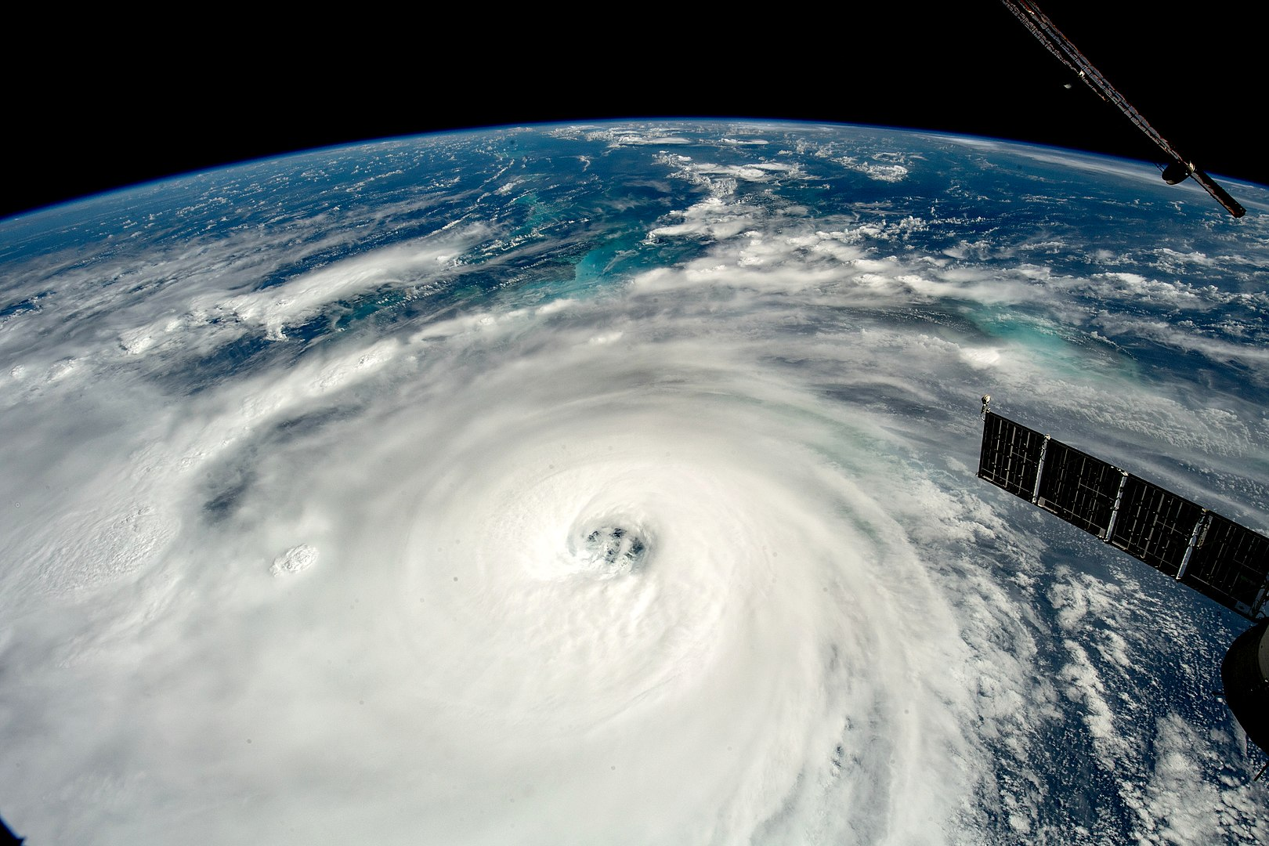
Climate change is no longer an abstraction, a distant threat. Storms are more severe.

Slide 3
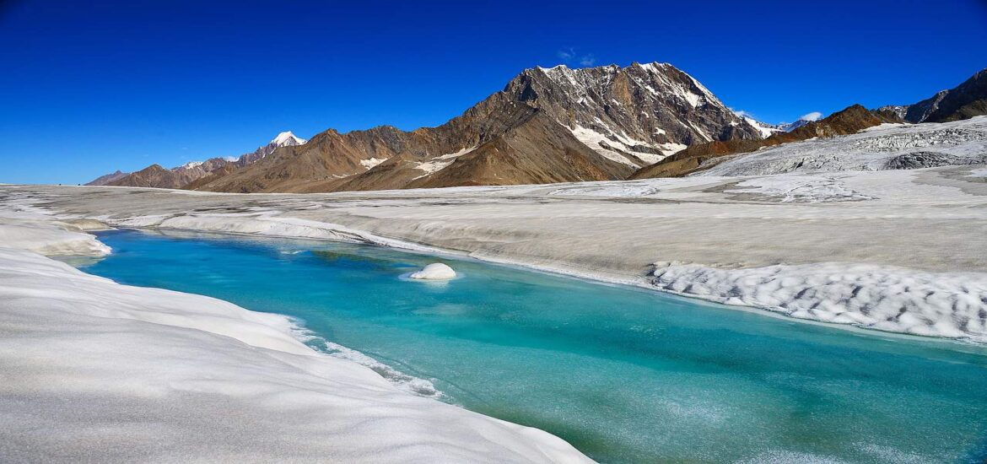
Glaciers are melting

Slide 4
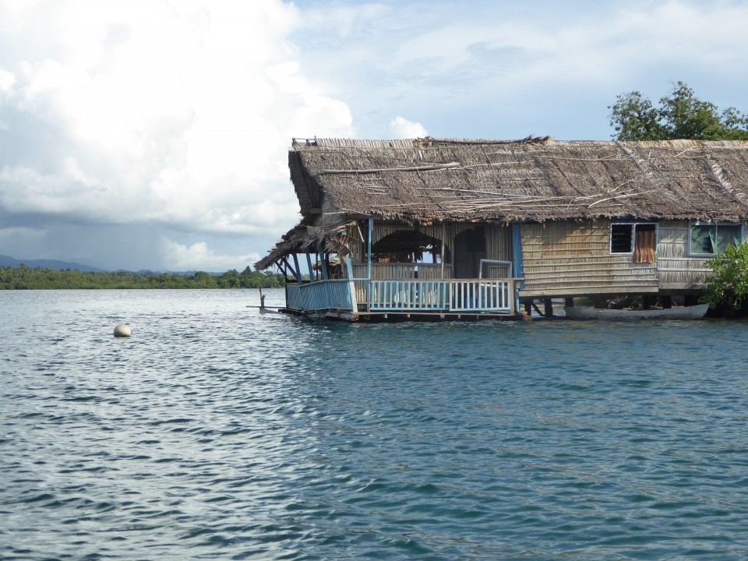
Sea levels are rising

Slide 5
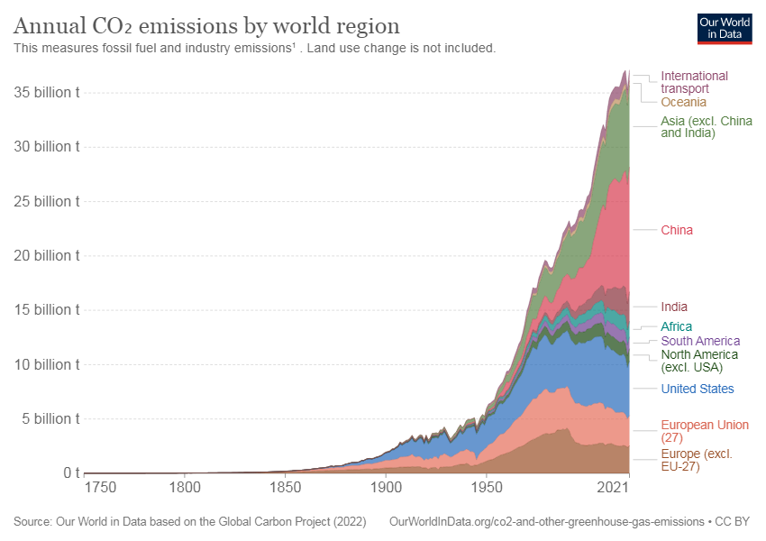
The main culprit – carbon

Slide 6
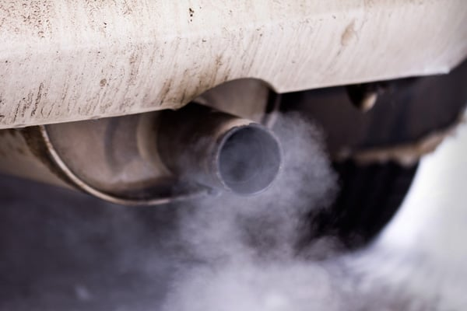
Emitted by tailpipes

Slide 7
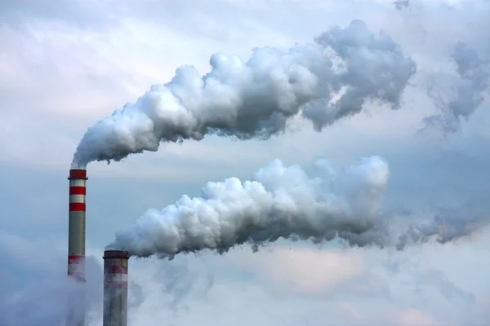
Smokestacks

Slide 8
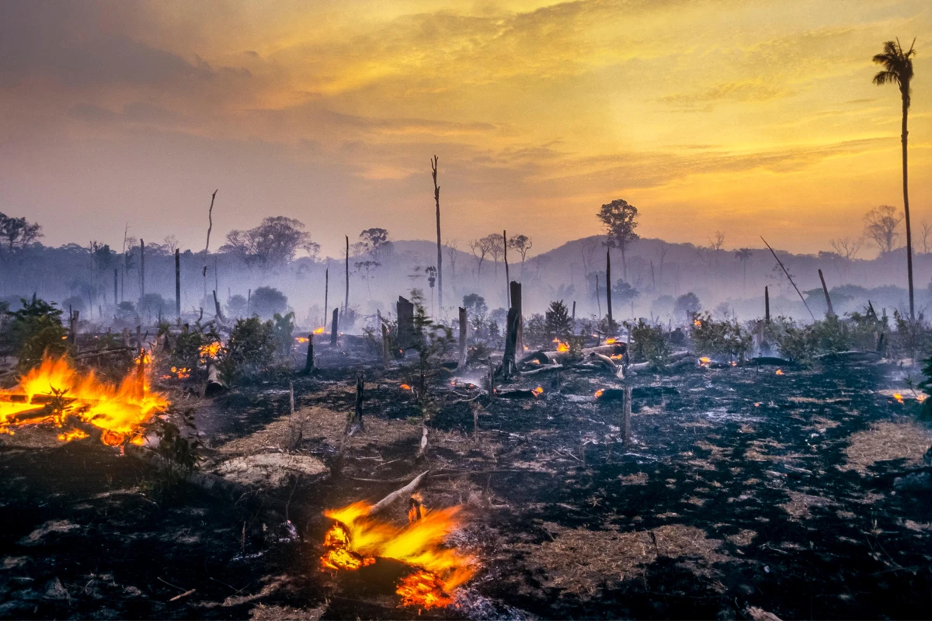
And deforestation in the tropics

Slide 9
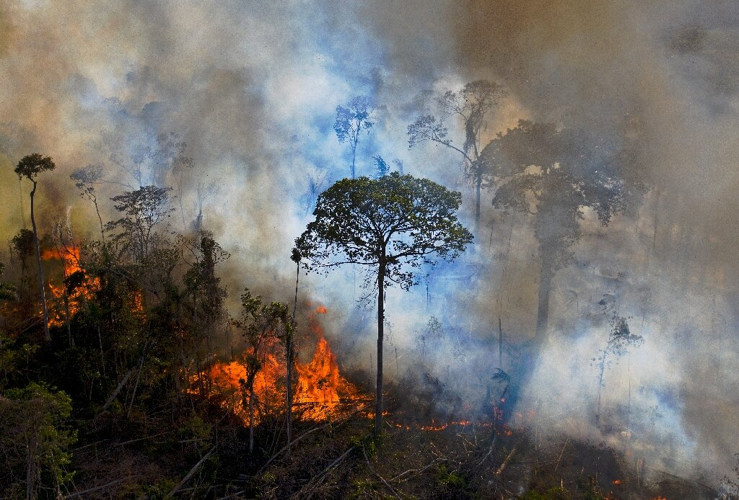
Students can help curb climate change by saving tropical forests

Slide 10
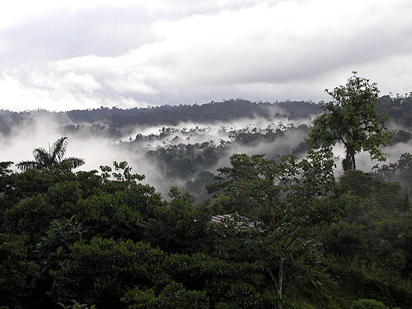
A good place to start is the Save the Rainforest website

