Slide 1
THE FOUR KINGS
Tropical Ocean
What’s so great about biodiversity hotspots?

Slide 2
Here’s your challenge:
Write about a biodiversity hotspot!
Here’s your to-do list:
Step 1
Learn about the world’s biodiversity hotspots and what makes them so incredible.
Step 2
Choose a biodiversity hotspot to explore and promote!
Step 3
Write a short article all about your biodiversity hotspot!

Slide 3
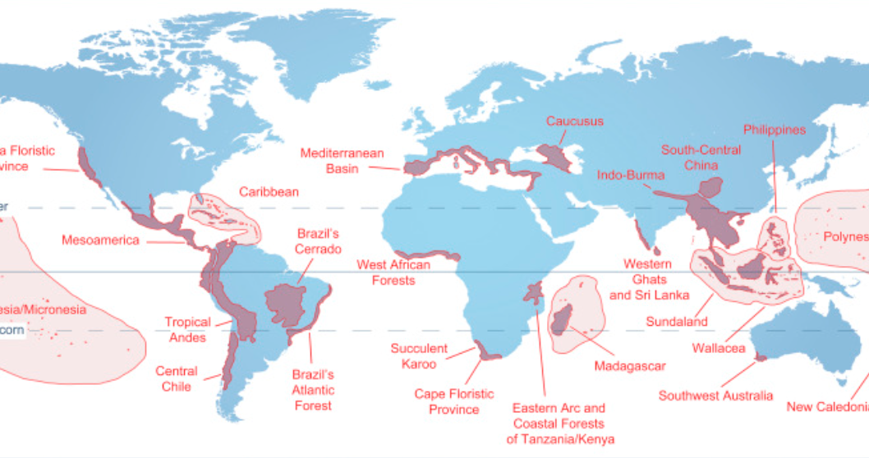
Biodiversity hotspots
Scientists try to identify places that are especially important when it comes to biodiversity. These can be on land or in the ocean.
These are regions that are home to a huge number of different species, or that are home to many endemic species.
When one of these special places is also at risk of habitat loss, it is called a “biodiversity hotspot.”
Map of land-based biodiversity hotspots, based on Myers et al. 2000 (Spicer, 2017)
Endemic species are species that are ONLY found in one particular region.
📕
Biodiversity hotspot formula:
Lots of different species
Many endemic species
Habitat loss
Biodiversity hotspot
or
+
=

Slide 4
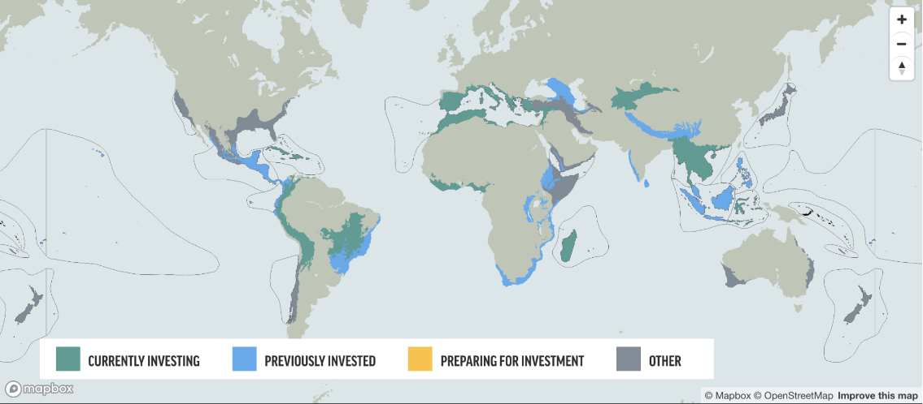
Biodiversity hotspots
Biodiversity hotspots can help scientists and conservationists identify areas that are most at risk and prioritize regions in need of immediate action.
🗺
Map of biodiversity hotspots by the Critical Ecosystem Partnership Fund (CEPF).
What’s the closest biodiversity hotspot to where you live?
Not sure of the answer?
Here are some websites to get you started:
Explore the Biodiversity Hotspots (Critical Ecosystem Partnership Fund)
What are Biodiversity Hotspots? (Frontiers for Young Minds)
Marine Protected Areas across Canada (DFO)
Priority Places for Biodiversity - Map (Half-Earth Project)

Slide 5
Biodiversity hotspots
Write a blog post!
One popular format for blog posts is the “listicle.”
You make a list, and explain why each item is on the list! We've all seen titles like "5 movies you have to watch before you graduate.” That’s a listicle!
Your challenge:
Choose a biodiversity hotspot and write a listicle about it!
You can choose anything to list about your biodiversity hotspot.
Here are some ideas for lists:
5 Unbelievable Species You’ll See in my Biodiversity Hotspot
5 Threats to the Habitat in my Biodiversity Hotspot
10 Reasons my Biodiversity Hotspot Should be Protected
3 Actions You Can Take to Protect my Biodiversity Hotspot
Ready to research?
Here are some websites to get you started:
Biodiversity: Facts and figures
Marine biodiversity hotspots
Tropical biodiversity: a superabundance

Slide 6
Website template
WRITE A TITLE, E.G., 6 REASONS WE NEED BIODIVERSITY
Write the author’s name and the date here.
Write the introduction to your article here.
Here’s my introduction, including the name of my hotspot, its location, and why I chose it.

Slide 7
Website template
1. Write your first fact here.
Here is more information about my first fact.
2. Write your second fact here.

Slide 8
Website template
3. Write your third fact here.
4. Write your fourth fact here.

Slide 9
Website template
5. Write your fifth fact here.
6. Write your sixth fact here.

