Slide 1

Introduce yourself in the chat!
Name
Affiliate
Affiliate Role
Land Acknowledgement
This Photo by Unknown Author is licensed under CC BY-NC-ND
Notes:
Sarah-welcome

Slide 2
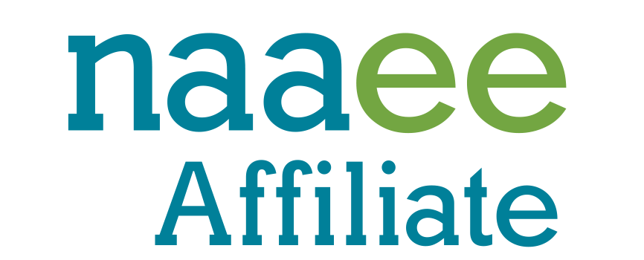
Growing and Strengthening the NAAEE Affiliate Network
Network Work Plan

Slide 3
The NAAEE Affiliate Network
As a collective, we hold each other accountable and advance…
We are a web of 54 affiliated organizations serving tens of thousands of educators across the continent.
Our network is the key to taking EE to scale.
policy
We are better together.
practice
We inform, inspire and spread the benefits of EE through every region and community.
Equity in environmental learning
Notes:
Katie

Slide 4
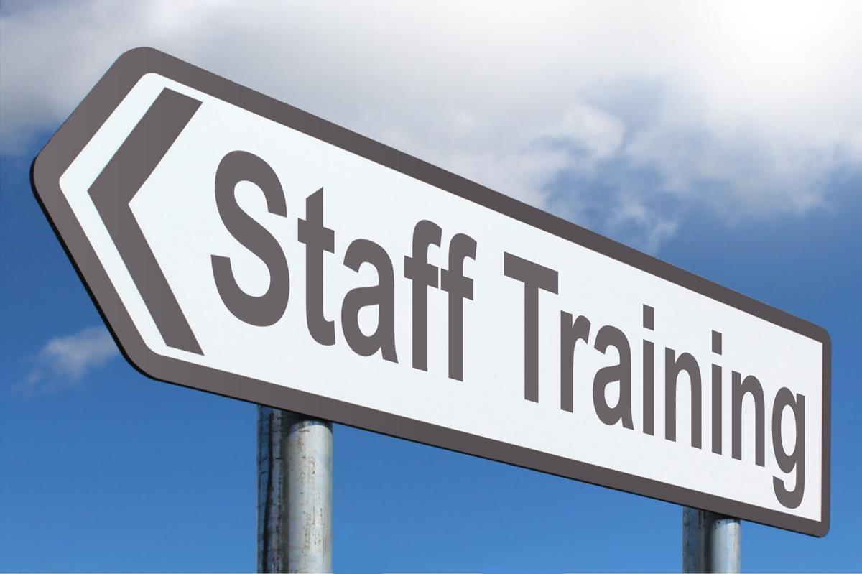
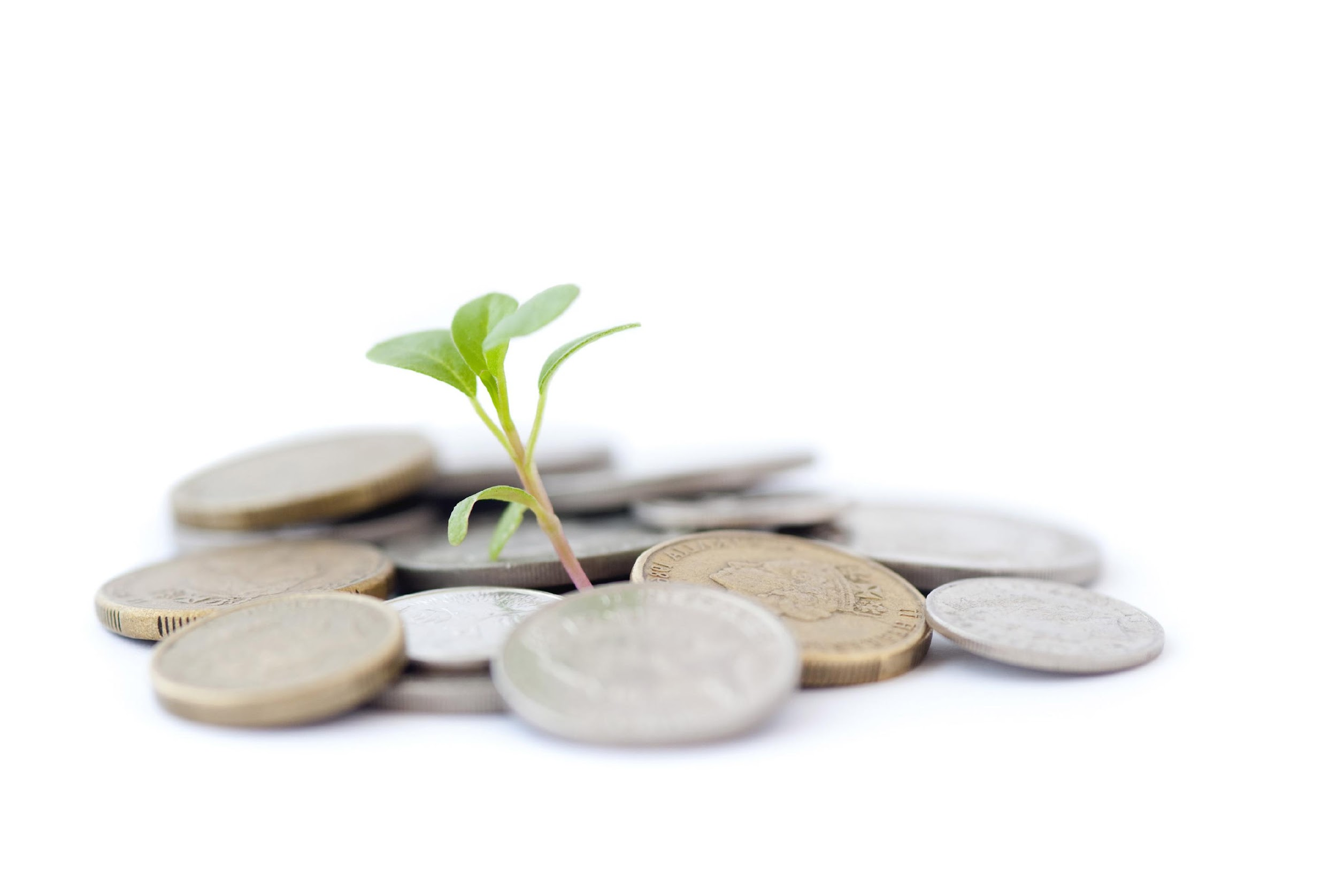
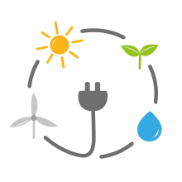

We are a powerful network!
Doubled Paid Staff
54 Charging Stations for EE
NAAEE and ee360 Increased Investment
150,000 Educators
Notes:
Katie

Slide 5
Our Goals Today:
Share our Process
Opportunities to Get Involved
Share Affiliate Stories
Notes:
Katie

Slide 6

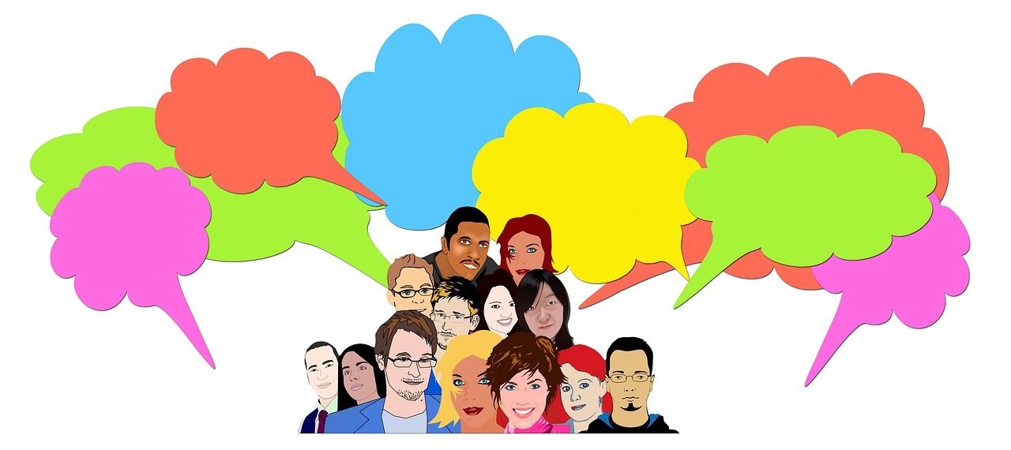
Thank YOU!
Affiliate Network Working Group
Affiliate Network Advisory Group
This Photo by Unknown Author is licensed under CC BY-NC-ND
This Photo by Unknown Author is licensed under CC BY-SA-NC
Notes:
Katie

Slide 7
Our Progress
2020
2021
2022
Affiliate Network 2.0 Working Group
Affiliate Network Goals
Affiliate Network Working Group
Affiliate Network Advisory Group
Local Concepts
Network Feedback
Affiliate Network Work Plan
Notes:
Bruce

Slide 8
Our Shared Network Goals
Capacity
Equity
Advocacy & Messaging
Innovate
Build the capacity of individual NAAEE affiliates, NAAEE, and the affiliate network to advance the field of Environmental Education
Increase equity and inclusion in Environmental Education through initiatives at individual NAAEE affiliates, NAAEE, and the affiliate network
Reach more people and increase support for Environmental Education through joint Advocacy and Messaging
Advance additional efforts to be a just, effective, and innovative network as they emerge
Notes:
Bruce

Slide 9
This Work Plan….
  is a 3-year plan to guide the Network’s work.
  will be used by the working and advisory group, committees, and NAAEE staff.
  will help individual Affiliates stay informed
  provides a way for Affiliates to tap in regardless of capacity.
  includes ideas for how Affiliates can support strategies.
This work plan does not…
  solely rely on backbone commitment, but is agreed to and supported by the Network.
  dictate individual Affiliate work plans.
  encompass all things that all Affiliates are working on.
  identify specific people for approaches.
Notes:
Bruce

Slide 10
Network Strategies -> Layers of Impact
Affiliate Network
NAAEE
Individual Affiliates
Notes:
Katie

Slide 11
Goal 1: Building our Capacity
Strategies for Building a Strong Network
1
2
3
Create high-functioning network governance, operating procedures, and organizational culture.
Ensure Network leaders represent a diversity of backgrounds, identities, skills, geographies, and types of Affiliates.
Create opportunities to build relationships and
connections within the Network.
Notes:
Katie

Slide 12




How to support
Share Network Leadership Opportunities with Boards and Members
Actively Encourage staff, board, and member participation.
Look for opportunities to share your Affiliates successes.
Apply for opportunities to attend the conference, leadership clinics, etc.
Notes:
Katie

Slide 13
Goal 1: Building our Capacity
Strategies for Building a Strong Affiliates
4
5
Provide continued professional development and learning opportunities to support Affiliate growth
Improve and enhance resources available to the
Network for capacity building.
Notes:
Katie

Slide 14




How to support:
Join an Affinity Group or Committee
Professional Development Committee (3rd Thursday 2pm ET)
Affiliate Network Community Check-in (3rd Wednesday 2pm ET)
Fund Development Community of Practice (Bimonthly)
Affiliate Staff Networking (1st Tuesday 2pm ET)
Affiliate ED Call (Last Wednesday 3pm ET)
Notes:
Katie

Slide 15
Goal 2: Equity and Inclusion
Strategies for Building a Strong Network
1
2
3
Develop Network-wide JEDIA expectations upheld by the Affiliate Network Working and Advisory Groups.
Define and model JEDIA best practices within our
own groups
Create a suite of JEDIA based organizational
assessment tools
Notes:
Bruce-Based on input collected for the past couple of years

Slide 16
Goal 2: Equity and Inclusion
Strategies for Building a Equitable Affiliates
4
5
Create expectations and accountability measures
for Affiliates
Support Affiliates that are implementing JEDIA initiatives at the Affiliate level and highlight achievements.
Notes:
Bruce

Slide 17


How to support:
Affiliate Network EDI Working Group (2nd Tuesday 2pm ET)
Affiliate Network Community Check-in (3rd Wednesday 2pm ET- Quarterly)
Share successes, challenges, and resources with the network.
Be a part of the development of tools. Or implement and use them!
Notes:
Bruce

Slide 18
Goal 3: Advocacy and Shared Messaging
1
2
3
Build Affiliate leadership for environmental
education advocacy.
Create a unified voice and messaging for
environmental education and the Network.
Build coalitions and strong partnerships.
Notes:
Sarah

Slide 19
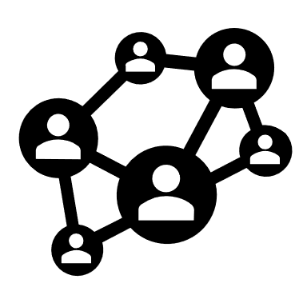



How to support:
Affiliate Advocacy Group (Polling for meeting times)
Monthly NAAEE Advocacy Calls (1st Thursday 1pm ET)
Watch for Shared messaging tools coming soon!
Promote your Affiliate’s Involvement in the Network.
Notes:
Sarah

Slide 20
Goal 4: Innovation and Shared Learning
1
!
!
Develop guidelines and strategies to help affiliates innovate, self-organize, and connect.
Emergent Ideas……
More Great Ideas….
Notes:
Bruce- Based on input collected for the past couple of years

Slide 21


How to support:
Affiliate Network Community Check-in (3rd Wednesday 2pm ET)
Suggest Topics for Deeper Discussion or Convening Around
Participate in Communities of Practice, Committees, and Ad Hoc Groups
Notes:
Give an example of what Goal
Bruce

Slide 22
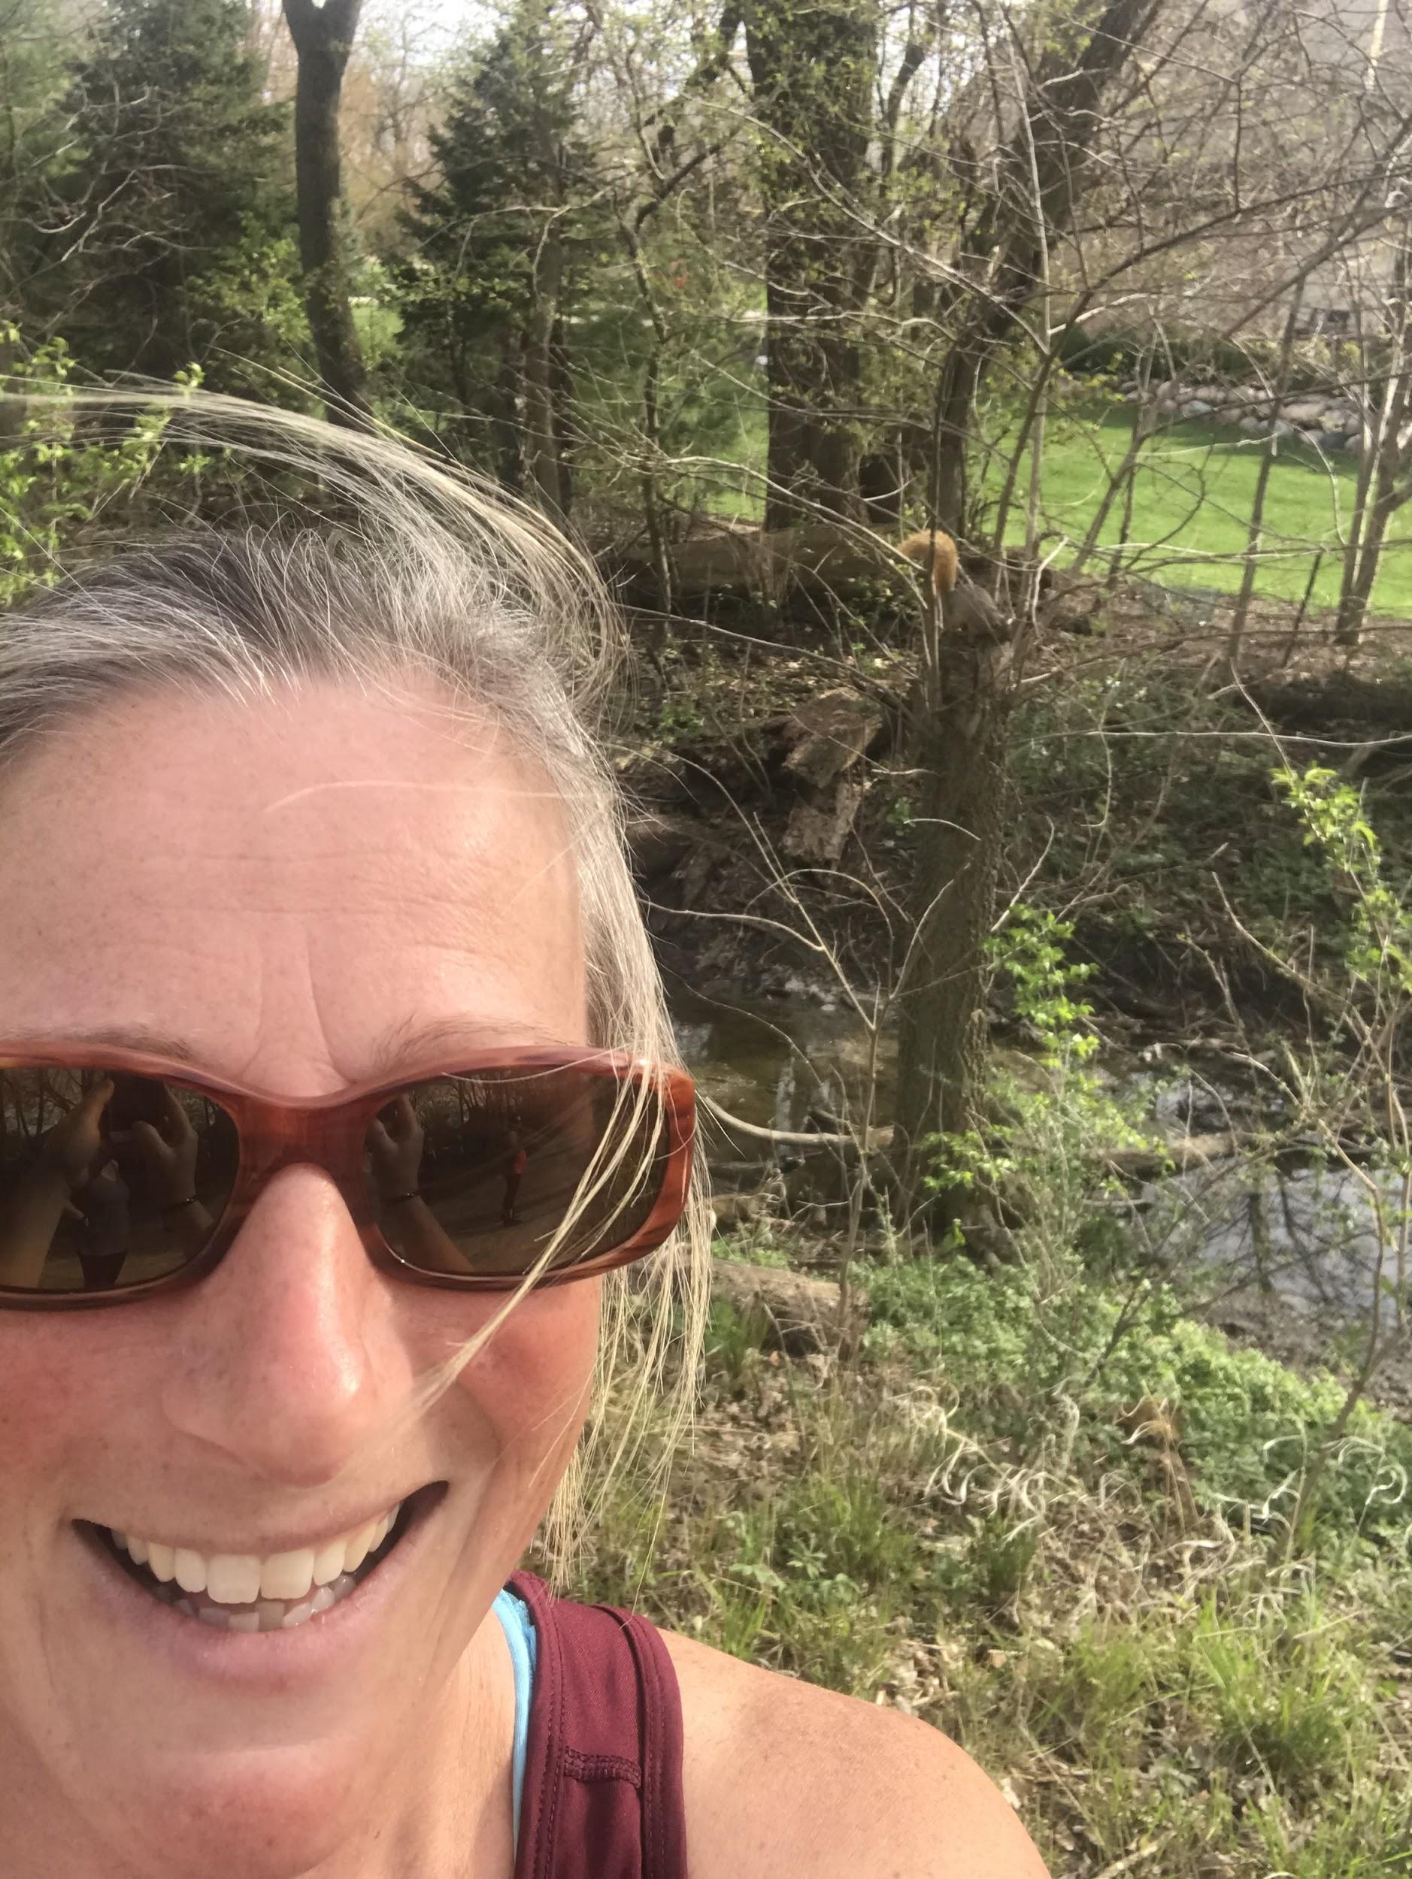
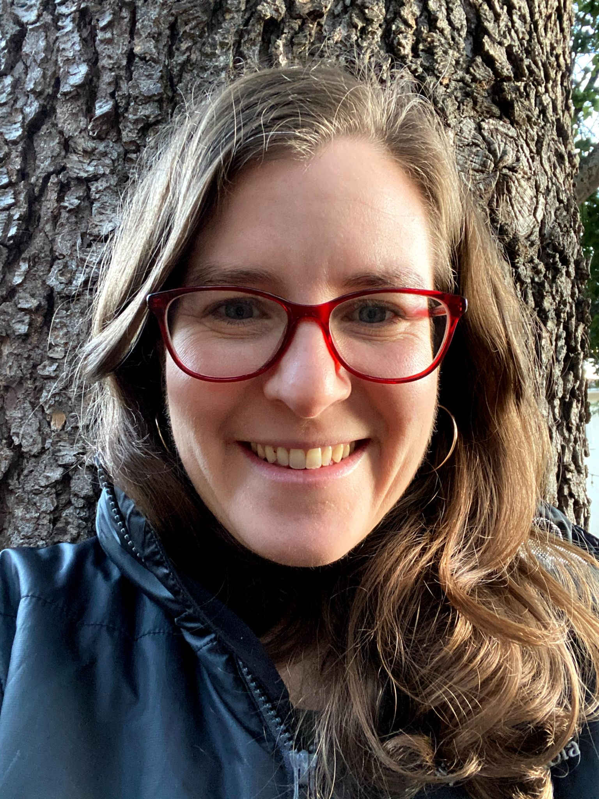
Affiliate Highlight: How are you using and sharing the work plan?
Abbie Enlund
Environmental Education Association of Illinois
EstrellaRisinger
California Association for Environmental and Outdoor Education
Notes:
Abbie & Estrella

Slide 23

More Opportunities
Tea Times
Wednesday, March 16th from 2-3pm ET
Tuesday, March 22nd from 8-9pm ET
Explore the Work Plan
Notes:
Tea Time Dates, link to plan, chairs of committees

Slide 24

Questions and Discussion
Notes:
Fill out the survey

Slide 25
Contacts
General Questions | Bruce Young (bruce@naaee.org)
Professional Development Committee | Abbie Enlund (executivedirectoreeai@gmail.com and Bruce Young (bruce@naaee.org)
Affiliate Network Community Check-In | Bruce Young (bruce@naaee.org)
Fund Development Community of Practice | Sophia Stephenson (director@arkansasee.org)
Executive Director Peer Mentoring | Laura Downey (ldowney@kacee.org) and Ashley Hoffman (director@kaee.org)
Affiliate Staff Networking | Lisa Eadens (lisaeadens@caee.org) and Bruce Young (Bruce@naaee.org)
EDI Working Group | Olivia Griset (olivia@meeassociation.org) and Eileen Everett (director@eeanm.org)
Affiliate Advocacy Group/ Monthly NAAEE Advocacy Calls | Sarah Bodor (sarah@naaee.org) and Jeanine Silversmith (jsilversmith@rieea.org (Email Bruce to be added to Google Group)

